Slide 1
Online Appointment System
Bhushan Sawale
Sumit Sonawane
Shashank Gaikwad

Slide 2
Abstract
Sometimes you come across small problems where you to need consult doctors about your health problems or for the nearest ones and follow their prescriptions. Online appointment system will provide you the power of direct interaction between doctors of your choice as and when required for your small problems. Using this web applications, patients will able to fill online form in just few seconds before entering to hospital.

Slide 3
Existing System
Under manual system, you have to first wait in line to take appointment for the doctors and wait for your time to have meet with them and discuss on your health problems. As you have to provide your information and other reports many times at different places such as the medicine store which is again a burden of carrying documents. You have to be present physically at the doctor’s cabin. Patients have to visit on another day of after some hours to take their health reports which involves extra care person with patients anytime.

Slide 4
Drawbacks in Existing System
Patients have to wait in line for taking appointments
Requires more resources (hospital staff)
Limited working hours. Patients can take appointments during hospital’s working hours only
Extra time requires for managing appointments
Mistakes can happen from staff while managing appointments

Slide 5
Proposed System
Manual process has been automated through this system. Patient have to fill online form for registration. Through this panel, patients can select the doctors and have appointment with them on their time from their own place. Patients will get all their medicine prescriptions in their profile just after appointment session.

Slide 6
Who are the users of the system?
Admin – Can access patients and doctors and delete accounts
Patient – Will able to request for appointment after registration
Doctor – View his schedule and give medicine prescriptions after appointment

Slide 7
Hardware & Software requirements.
Development Environment Specifications
Operating System – Windows
Server – IIS
Database – MS Access
Technologies Used – ASP, HTML, CSS, JavaScript

Slide 8
Features of the system
Authorized access to the users of the system
Patient can request appointment 24 x 7
Appointment scheduling is automated, no staff is required
Patient can
  Request Appointment
  View his requested appointment details
  Cancel Appointment
  View Medical Prescriptions on his profile
  Update Basic Information
  Reset Password
Doctor can
  View his upcoming appointment scheduled
  Can give medical prescription to patient after appointment
  Update Basic Information
  Reset Password

Slide 9
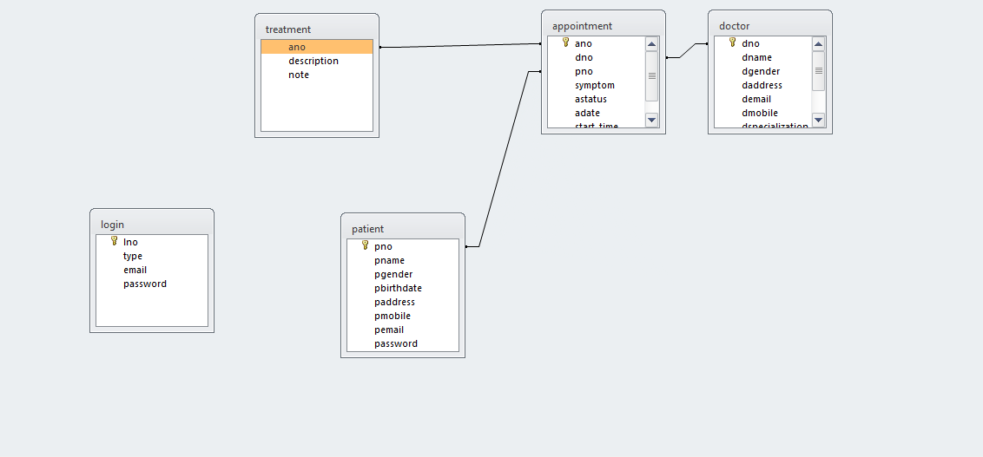
Data Flow Of The System

Slide 10
Advantages Of System
Automated appointment scheduling
Human errors are completely eliminated
Easy Accessibility
Reduces strain on hospital staff
Waiting time for patient is reduced
Convenient for both patients and doctors
Receptionist conflict is avoided

Slide 11
Future Enhancement
For future enhancement we are planning to add different features like:
Push notifications via email and sms
Feature to view/upload/download lab reports on profile
Feature to edit appointment date and time after booking an appointment
Feature for online payment
Feedback feature

Slide 12
Bibliography
For the development of this project we made use of the internet websites like
www.w3schools.com
www.tutorialspoints.com
www.stackoverflow.com

